Slide 1
Meeshu Gupta
meeshugupta88@gmail.com
Submission- Minor Project

Slide 2
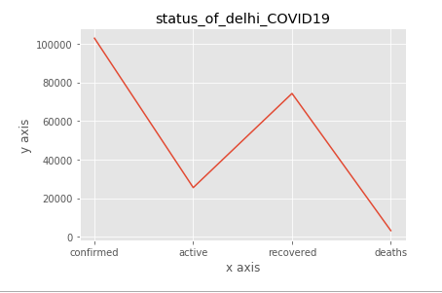
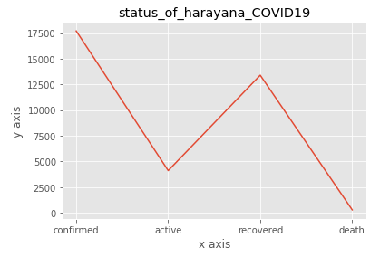
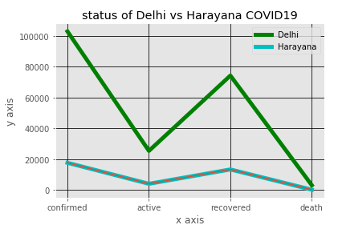
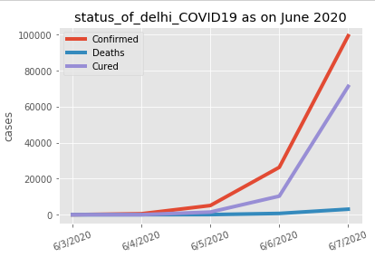
Status of Delhi (Cumulative and Manually)- copied data from
www.covid19india.org
Status of Harayana (Cumulative)-copied data from
www.covid19india.org
Delhi vs Haryana (Cumulative)-copied data from
www.covid19india.org
The results showed that Delhi has poor performance in handling covid19 situation as compared to Delhi. Despite of the fact that some of the major cities such Gurugram and Faridabad falls under NCR and takes major chunk of Delhi’s population commuting in between for various reasons.
Total confirmed case of Delhi 102831 as compared to Haryana 17700
Cases active in Delhi 25449 against Haryana it is 4101 and similarly for recovered (74217 vs 13393 and death (3165 vs 276)
Possible reasons for such difference might be:
Administrative reasons- opening of offices, markets and etc. by Delhi Government
May be rigorous screening in Delhi as compared to Haryana which may screened lesser case as compared to actual unidentified/tested cases
People are sensitized and well informed in delhi as compared to Haryana
Delhi also a hotspot of foreign travelers and immigration
Higher chunk of affluent section in delhi as compared to Haryana (wrt to international travel only not community spread)
Status of Delhi in June month (used covid19.csv file)

